Slide 1
Project Presentation
Distributed Text Mining Pipeline Using Hadoop MapReduce
Group 3
Our group is developing a distributed text mining pipeline to analyze large collections of literary works using parallel computing techniques. The goal is to process a corpus of publicly available novels and group them by popularity to determine whether measurable linguistic and stylistic patterns are associated with successful works. Tasks such as tokenization, n-gram extraction, and TF-IDF computation are implemented using Hadoop MapReduce across HDFS-stored data, with the system containerized via Singularity for reproducibility.
Group 3
Lara Hamo (lxh639@case.edu)
Hy Nguyen (hxn232@case.edu)
Maximillian Malz (mxm2004@case.edu)
Kadijah Taylor (kmt86@case.edu)
April 27, 2026

Slide 2
Background
Distributed Computing & Hadoop MapReduce
HDFS Distributed Storage Architecture
Text Mining: TF-IDF & N-gram Extraction
Literary Corpus Analysis & Popularity Metrics
Singularity Containerization for Reproducibility
Scalability & Performance Evaluation

Slide 3
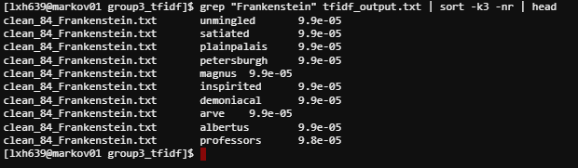
TF-IDF Computation Using MapReduce Overview
Overview:
Term Frequency (TF): frequency of a word in a document
Inverse Document Frequency (IDF): rarity of word across all documents
Purpose in Project:
Identifies important words in each novel
Filters out common words (such as “the”, “and”, “a”)
Comparisons of linguistic patterns

Slide 4
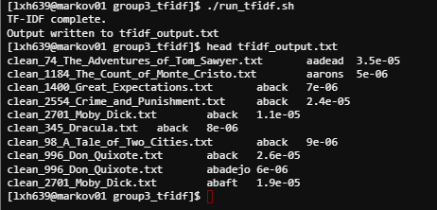
TF-IDF Computation Using MapReduce Implementation
Pipeline Integration:
Input: cleaned novels from preprocessing (cleaned_novels)
Output: TF-IDF scores (tfidf_output.txt)
MapReduce Workflow
Mapper:
Emits (word, document, count)
Reducer
Computes TF per document
Computes IDF across all documents
Outputs TF-IDF scores
Execution
Implemented using Python-based Hadoop streaming style
Executed via shell script pipeline (run_tfidf.sh)

Slide 5
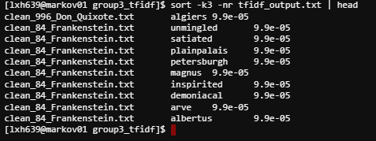
TF-IDF Computation Using MapReduce Results
Output:
Generated TF-IDF scores for all novels (~1.9 words total)
Output format: document, word, TF-IDF score
Insights from results:
High-popularity novels:
Emphasis on social and emotional vocab
Medium-popularity novels:
Dark, psychological terms
Low-popularity novels:
Archaic and formal vocab

Slide 6
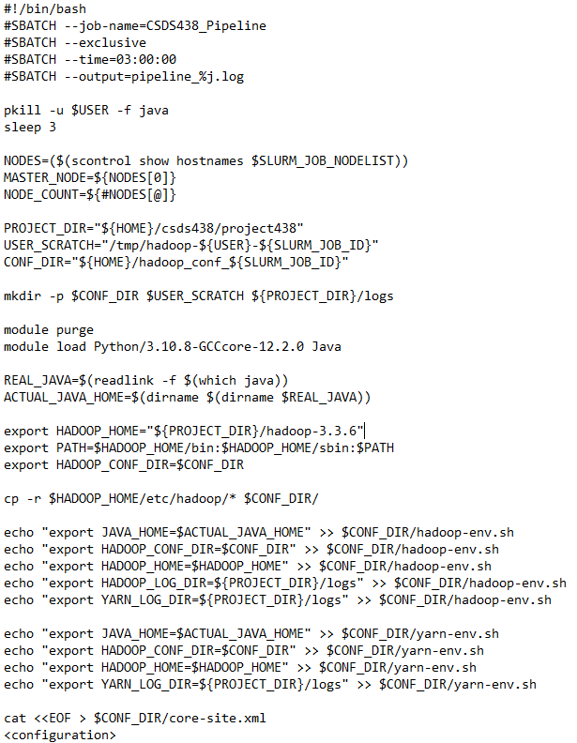
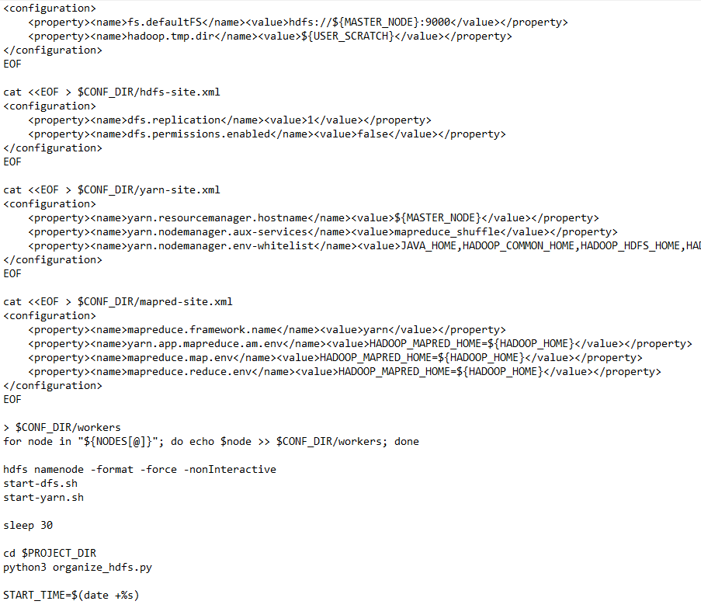
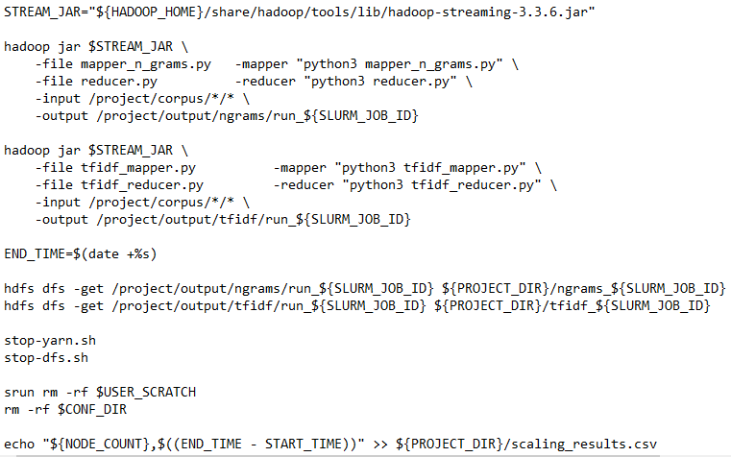
Hadoop Configuration
Parallize the operations as a whole through multiple nodes
Run a slurm job for each node number job
Generates XML config files inside slurm job, as well as using JAVA, HDFS and YARN
Single slurm job that would do everything on it’s own and clean up on itself.

Slide 7
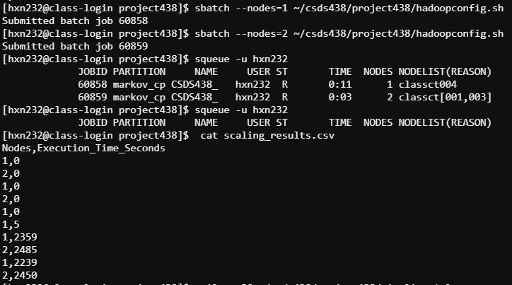
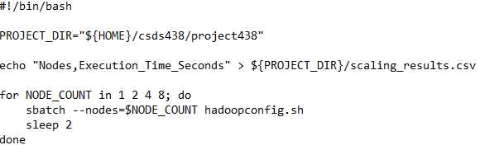
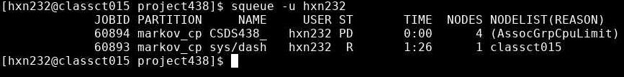
Performance & Scalability Testing
Tried to make a slurm job to submit batch jobs all at once, but didn’t seem to work with testing 4 nodes and 8 nodes.
Had to make a hadoop folder inside for testing with:
wget https://archive.apache.org/dist/hadoop/common/hadoop-3.3.6/hadoop-3.3.6.tar.gz
tar -xzf hadoop-3.3.6.tar.gz
Could perform performance tests on 1 nodes and 2 nodes, but 4 and 8 nodes were not successful with the current iteration of config/codes?
Seemed to perform the same between 1 nodes and 2 nodes but that would be likely change when scaling with larger datasets / more nodes as well

Slide 8
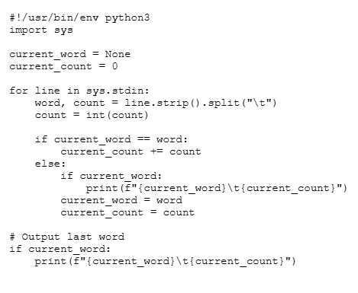
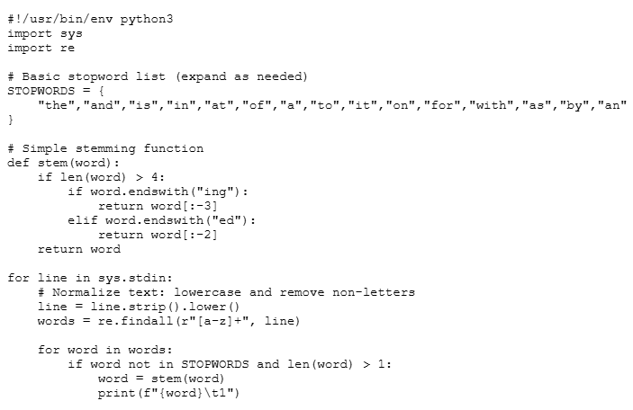
Text Pre-processing Implementation
Cleaning (remove punctuation, lowercase)
Tokenization (split into words)
Stopword removal (remove common words)
Stemming (reduce to root form)
Notes:
To analyze large collections of novels, we first needed to transform raw text into a structured format. Raw text is inherently noisy—containing punctuation, inconsistent casing, and common words that don’t contribute meaningful insight.
To address this, we built a scalable text preprocessing pipeline using Hadoop Streaming with Python.
We chose Python for the streaming implementation because it offers a balance between simplicity and flexibility. It allows us to quickly implement text processing logic while still integrating seamlessly with Hadoop’s distributed architecture.
The preprocessing happens primarily in the mapper. Each mapper processes a chunk of text independently and performs several steps:
First, it normalizes the text by converting everything to lowercase and removing non-alphabetic characters.
Next, it tokenizes the text into individual words.
Then, it removes stopwords—common words like ‘the’ or ‘and’ that don’t add analytical value.
Finally, it applies stemming to reduce words to their base form, allowing us to group similar terms together.
After preprocessing, the mapper emits key-value pairs in the form of a word or phrase and a count of one.
The reducer then aggregates these counts across all nodes, producing the total frequency of each term or phrase in the dataset.

Slide 9
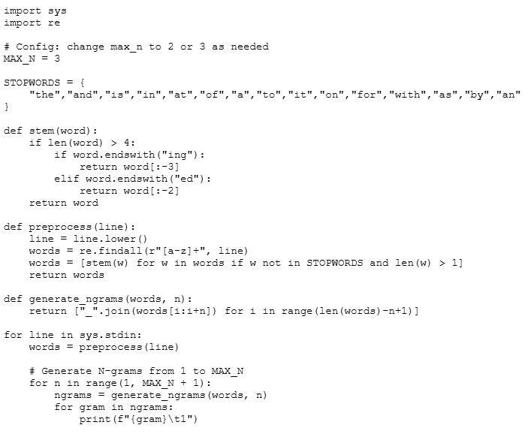
N-gram Extraction & Analysis
Captures word sequences (context)
Supports:
Unigrams (single words)
Bigrams (2-word phrases)
Trigrams (3-word phrases)
Notes:
To go beyond single-word analysis, we extended the pipeline to generate N-grams.
This allows us to capture meaningful phrases, such as ‘dark forest’ or ‘true love,’ rather than just individual words. The difference for running with ngrams and without is the preprocessing the line and generate the n grams. The only change is in the mapper file the same reducer python script can be used with and without n-grams implementation.
By doing this, we gain better insight into patterns and themes across different categories of novels.

Slide 10
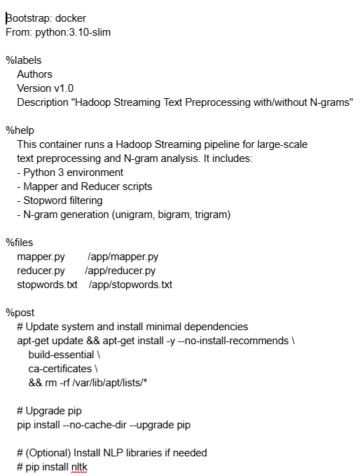
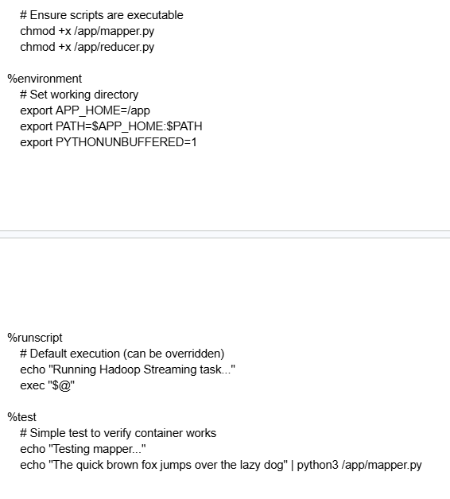
Singularity Containerization
Problem
Inconsistent environments across nodes
Dependency conflicts
Solution
Package everything into a container
Workflow Diagram
[Singularity Container]
↓ distributed to nodes
[Node 1] [Node 2] [Node 3]
↓ ↓ ↓
Same Mapper + Reducer Execution
Notes:
There is a problem when running across nodes that the environments are inconsistent and that there are dependency conflicts so the solution to the problem is to put everything into a container. So We created a Singularity definition file that packages our entire preprocessing pipeline—including N-gram generation—into a portable container. This ensures that every node in the Hadoop cluster runs the same environment, eliminating inconsistencies and enabling reproducible large-scale analysis.

Slide 11
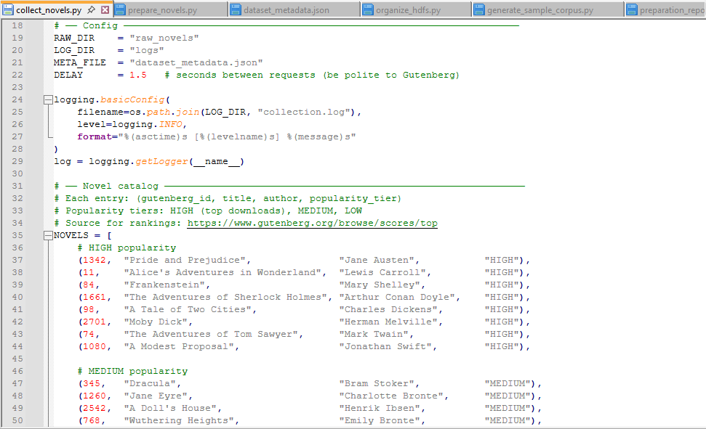
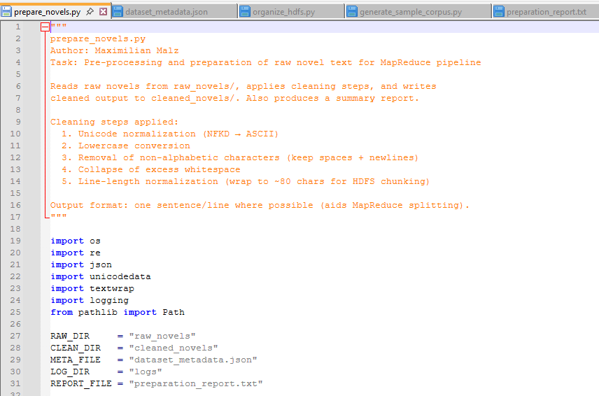
Dataset Collection & Preparation
24 novels from Project Gutenberg. HIGH, MEDIUM, LOW popularity tiers
HIGH .. Pride & Prejudice, Frankenstein, Sherlock Holmes (~81k words)
MEDIUM .. Dracula, Crime & Punishment, Dorian Gray (~56k words)
LOW .. Don Quixote, Great Expectations, Leviathan (~102k words)
Collect ..novels.py: dual-URL fallback, rate-limited, boilerplate stripped
Output .. one sentence per line for Hadoop TextInputFormat
Notes:
Hi everyone, my name is Max Malz. I’ll be covering the data collection and preparation portion of our project, including how we built the dataset and structured it in HDFS so the full pipeline could run efficiently in a distributed environment. Then I’ll be closing us out with future research and the conclusion, where this work can go next, how it can scale, and the bigger picture of what we found. For this project I was responsible for two things: building the dataset and organizing it in the distributed file system.
For the dataset, we pulled 24 novels from Project Gutenberg, that's a public domain literary archive. We split them into three popularity tiers based on Gutenberg's own download rankings. HIGH tier is your most-downloaded classics, Pride and Prejudice, Frankenstein, Sherlock Holmes. MEDIUM is well-known but less downloaded, Dracula, Crime and Punishment, Dorian Gray. LOW tier rounds it out with Don Quixote, Great Expectations, Leviathan.
I automated the entire collection with a Python script called collect_novels.py. It tries two different URL formats per book since Gutenberg isn't consistent, respects their rate limits with a delay between requests, and strips out the legal boilerplate that appears at the top and bottom of every file.
After collection I ran a cleaning pipeline: unicode normalization, sentence splitting, lowercasing, removing non-alphabetic characters. The key design decision was outputting one sentence per line, because that's exactly what Hadoop's TextInputFormat expects when it splits input across mappers.

Slide 12
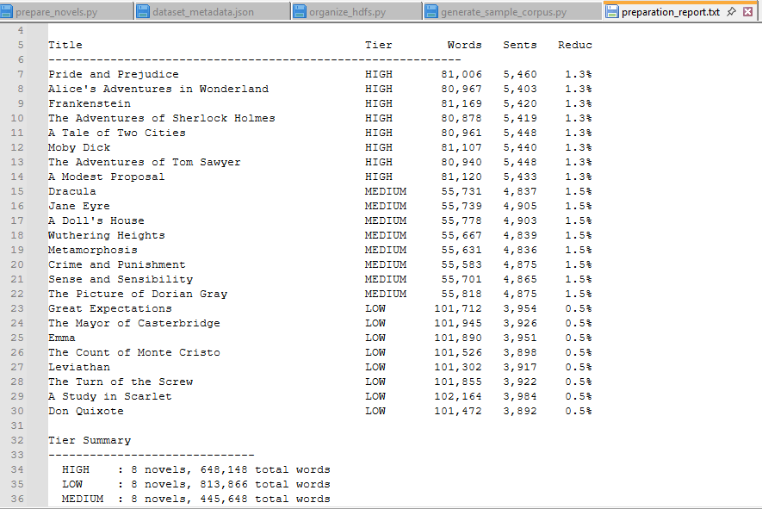
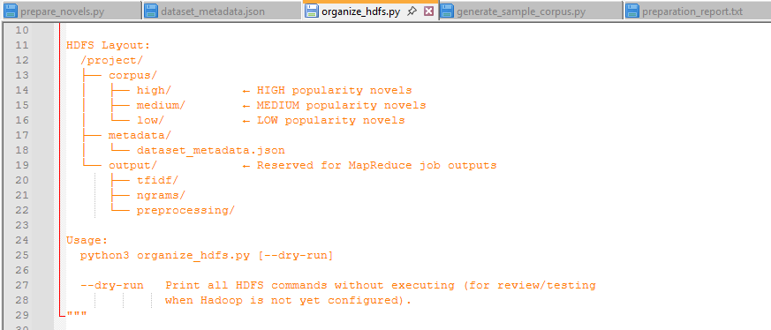
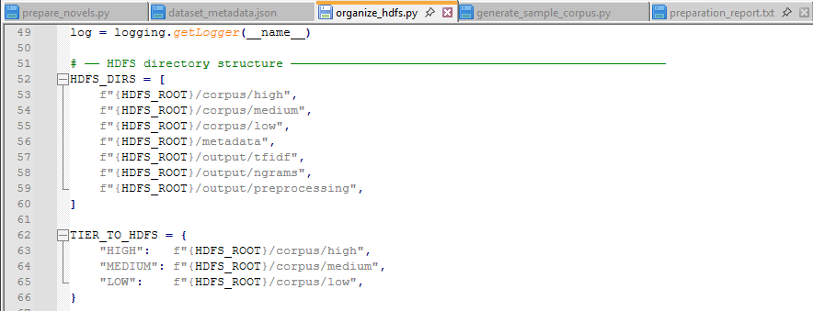
HDFS Data Organization
HDFS root at /project/ .. scripted via organize_hdfs.py
/project/corpus/high|medium|low/ .. partitioned by popularity tier
/project/metadata/dataset_metadata.json .. shared across all jobs
/project/output/tfidf|ngrams|preprocessing/ .. pre-created output dirs
All output dirs chmod 775 .. jobs never fail on missing permissions
--dry-run flag .. preview hdfs commands without a live cluster
Notes:
Once the novels were cleaned, I set up the HDFS structure that the whole pipeline runs on.
The root is /project/, and under that I created a corpus directory partitioned into high, medium, and low, so if any MapReduce job only needs to process one tier, it can point directly at that folder without filtering logic.
The metadata JSON is also uploaded to HDFS under /project/metadata/, which means any job running anywhere on the cluster can read it without needing access to local disk.
The most important detail is the output directories. I pre-created /project/output/tfidf/, /project/output/ngrams/, and /project/output/preprocessing/ before any job runs, and set them to chmod 775. If a MapReduce job tries to write to a directory that doesn't exist in HDFS, it just fails. so creating them upfront means no one's job dies for an infrastructure reason.
The script also has a --dry-run mode which prints every hdfs command it would run without executing anything. That's how I validated the full structure in a sandboxed environment before we had a live cluster.

Slide 13
Future Research
Run full TF-IDF and n-gram pipeline on live Hadoop cluster at scale
Validate preliminary findings across the complete 1.9M word corpus
Expand dataset: additional novels, broader popularity signals
Explore alternative popularity metrics beyond download counts
Test scalability by varying number of MapReduce nodes
Apply pipeline to other literary corpora or languages
Notes:
Looking ahead, the most immediate next step is running the full pipeline on the live Hadoop cluster. The preliminary analysis I showed already reveals clear patterns across the three tiers, but those were run locally on the cleaned corpus. We need to validate those findings at scale using the actual distributed MapReduce jobs. The TF-IDF computation, n-gram extraction, and tokenization all running in parallel across HDFS.
Beyond that, there's room to expand the dataset itself. Twenty-four novels gives us a reasonable signal, but a larger corpus would strengthen the statistical validity of any conclusions we draw. We could also look at alternative ways to define popularity. Gutenberg downloads are a proxy, but factors like adaptations, citations, or academic reception might paint a different picture.
Finally, the pipeline we've built is general enough to apply to other corpora entirely. Other languages, other genres, or even non-literary text collections could all be processed through the same system with minimal changes.

Slide 14
Conclusion
Built a distributed text mining pipeline using Hadoop MapReduce and HDFS
Corpus: 24 novels across HIGH, MEDIUM, LOW popularity tiers — 1.9M words
Preliminary results show measurable linguistic differences across tiers
HIGH tier: shorter sentences, simpler vocabulary, higher lexical diversity
LOW tier: longer sentences, archaic vocabulary, lower local diversity
System containerized via Singularity for full reproducibility
Notes:
To summarize, we set out to answer whether popular literary works have measurable and consistent linguistic patterns, and the early evidence says yes. We built a full distributed text mining pipeline from the ground up. The dataset is 24 novels organized into three popularity tiers, cleaned and loaded into HDFS, with MapReduce jobs handling TF-IDF computation, n-gram extraction, and tokenization in parallel. The preliminary findings are concrete. HIGH popularity novels average around 15 words per sentence. LOW popularity novels average nearly 26, over 70% longer. HIGH tier vocabulary is simpler and more varied locally, while LOW tier is dominated by archaic, formal language. TF-IDF gives each tier a distinct fingerprint. Social vocabulary for HIGH, dark psychological vocabulary for MEDIUM, and archaic formal vocabulary for LOW. The full cluster run will tell us whether these patterns hold at scale, but the signal is already there. The pipeline is working, the data is in HDFS, and the infrastructure is ready. Thank you.

